Slide 1
“A Living Testimony”
Men’s Conference
2024

Slide 2
Acts 4:33
33 And with great power the apostles were giving testimony to the resurrection of the Lord Jesus, and abundant grace was upon them all.

Slide 3
Revelation 19:10
10 Then I fell at his feet to worship him. But he said to me, “Do not do that; I am a fellow servant of yours and your brethren who hold the testimony of Jesus; worship God. For the testimony of Jesus is the spirit of prophecy.”

Slide 4
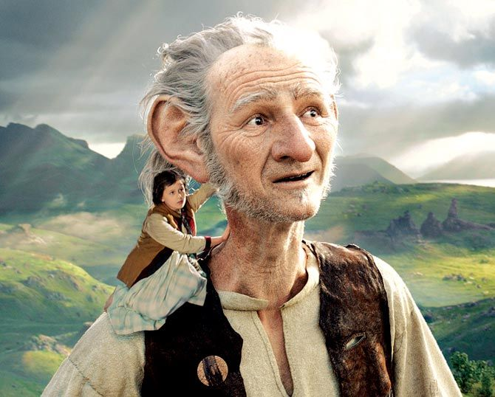

Slide 5
John 21:4
4 But when the day was now breaking, Jesus stood on the beach; yet the disciples did not know that it was Jesus.

Slide 6
The Ascension
CHRIST IS IN HEAVEN (He’s up there) AND….
WE ARE IN HIM!

Slide 7
Ephesians 1:6
6…He hath made us accepted in the beloved.

Slide 8
Romans 6:11
11 Even so consider yourselves to be dead to sin, but alive to God in Christ Jesus.

Slide 9
Romans 8:37
37 But in all these things we overwhelmingly conquer through Him who loved us.

Slide 10
The Ascension
CHRIST IS IN HEAVEN AND….
WE ARE IN HIM!

Slide 11
The Day of Pentecost
WE’RE DOWN HERE AND….
HE IS IN US!

Slide 12
Colossians 1:26-27
26 …that is, the mystery which has been hidden from the past ages and generations, but has now been manifested to His saints…
27 …which is, Christ in you, the hope of glory.

Slide 13
Galatians 2:20
20 …and it is no longer I who live, but Christ lives in me…

Slide 14
The Dawning of a New Day
ASCENSION:
CHRIST IS IN HEAVEN AND…
WE ARE IN HIM!
PENTECOST:
WE’RE DOWN HERE AND…
HE IS IN US!

Slide 15
WE BECOME A LIVING TESTIMONY!

Slide 16
Acts 9:32-42
32 Now as Peter was traveling through all those regions, he came down also to the saints who lived at Lydda.
33 There he found a man named Aeneas, who had been bedridden eight years, for he was paralyzed.
34 Peter said to him, “Aeneas, Jesus Christ heals you; get up and make your bed.” Immediately he got up.

Slide 17
Acts 9:32-42 cont.
35 And all who lived at Lydda and Sharon saw him, and they turned to the Lord.
36 Now in Joppa there was a disciple named Tabitha (which translated in Greek is called Dorcas); this woman was abounding with deeds of kindness and charity which she continually did.
37 And it happened at that time that she fell sick and died; and when they had washed her body, they laid it in an upper room.

Slide 18
Acts 9:32-42 cont.
38 Since Lydda was near Joppa, the disciples, having heard that Peter was there, sent two men to him, imploring him, “Do not delay in coming to us.”
39 So Peter arose and went with them. When he arrived, they brought him into the upper room; and all the widows stood beside him, weeping and showing all the tunics and garments that Dorcas used to make while she was with them.

Slide 19
Acts 9:32-42 cont.
40 But Peter sent them all out and knelt down and prayed, and turning to the body, he said, “Tabitha, arise.” And she opened her eyes and when she saw Peter, she sat up.
41 And he gave her his hand and raised her up; and calling the saints and widows, he presented her alive.
42 It became known all over Joppa, and many believed in the Lord.

Slide 20
A LIVING TESTIMONY IS:
1. A life that looks like Jesus!

Slide 21
Acts 9:33-34
33 There he found a man named Aeneas, who had been bedridden eight years, for he was paralyzed.
34 Peter said to him, “Aeneas…get up and make your bed.” Immediately he got up.

Slide 22
Mark 2:3, 11-12
3 And they came, bringing to Him a paralytic, carried by four men.
11 “I say to you, get up, pick up your pallet and go home.”
12 And he got up and immediately picked up the pallet and went out in the sight of everyone, so that they were all amazed and were glorifying God, saying, “We have never seen anything like this.”

Slide 23
Acts 9:37, 39-41
37 And it happened at that time that she fell sick and died; and when they had washed her body, they laid it in an upper room.
39 …When he (Peter) arrived, they brought him into the upper room…
40 But Peter sent them all out and knelt down and prayed, and turning to the body, he said, “Tabitha, arise.” And she opened her eyes and when she saw Peter, she sat up.
41 And he gave her his hand and raised her up; and calling the saints and widows, he presented her alive.

Slide 24
Mark 5:35-37
35 While He was still speaking, they came from the house of the synagogue official, saying, “Your daughter has died; why trouble the Teacher anymore?”
36 But Jesus, overhearing what was being spoken, said to the synagogue official, “Do not be afraid any longer, only believe.”
37 And He allowed no one to accompany Him, except Peter and James and John the brother of James.

Slide 25
Mark 5:40-42
40 …But putting them all out…He entered the room where the child was…
41 And taking the child by the hand, He said to her, “Talitha kum!” (which translated means, “Little girl, I say to you, get up!”)
42 Immediately the girl got up and began to walk, for she was twelve years old. And immediately they were completely astounded.

Slide 26
A LIVING TESTIMONY IS:
A life that looks like Jesus!
The reason it looks like Jesus is because IT IS JESUS!

Slide 27
Acts 9:34
34 Peter said to him, “Aeneas, Jesus Christ heals you; get up and make your bed.” Immediately he got up.

Slide 28
Acts 9:32-33, 38
32 Now as Peter was traveling through all those regions, he came down also to the saints who lived at Lydda.
33 There he found a man named Aeneas, who had been bedridden eight years, for he was paralyzed.
38 Since Lydda was near Joppa, the disciples, having heard that Peter was there, sent two men to him, imploring him, “Do not delay in coming to us.”

Slide 29
H
O
W
?

Slide 30
Philippians 2:13
13 …for it is God who is at work in you, both to will and to work for His good pleasure.

Slide 31
A LIVING TESTIMONY IS:
A life that looks like Jesus!
The reason it looks like Jesus is because IT IS JESUS!
A life that matters!

Slide 32
Acts 9:35, 42
35 And all who lived at Lydda and Sharon saw him, and they turned to the Lord.
42 It became known all over Joppa, and many believed in the Lord.

Slide 33
Hebrews 11:4
4 By faith Abel offered to God a better sacrifice than Cain, through which he obtained the testimony that he was righteous, God testifying about his gifts, and through faith, though he is dead, he still speaks.

